Slide 1
GraphQL Federation

Slide 2
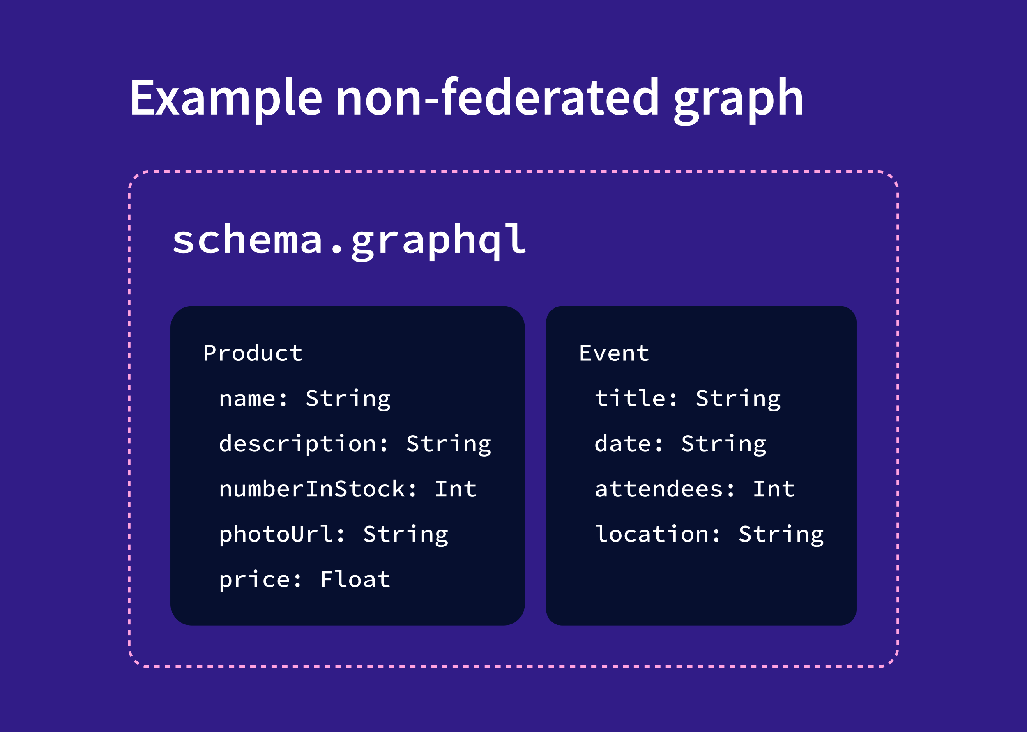
Example of Non-federated Graph

Slide 3
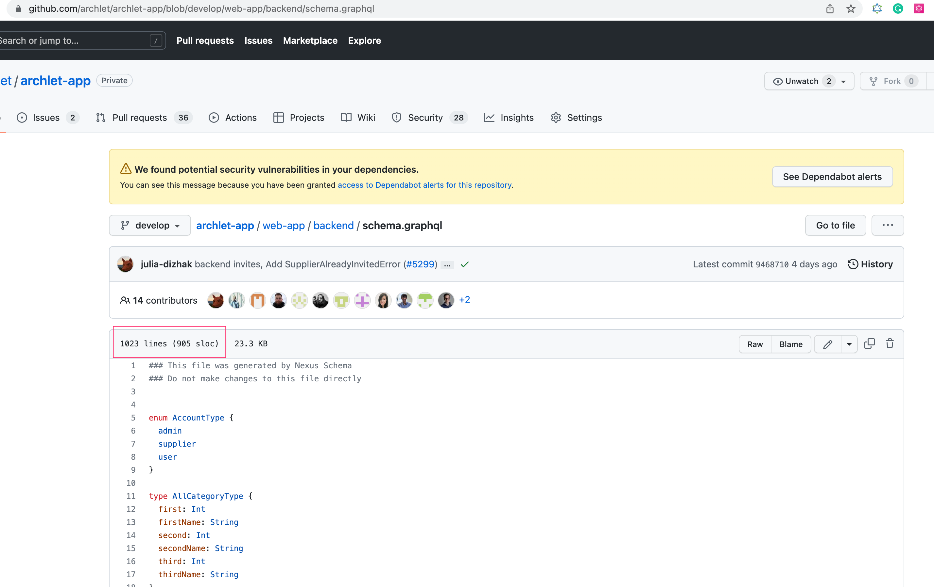
Non-federated schema

Slide 4
Apollo Federation

Slide 5
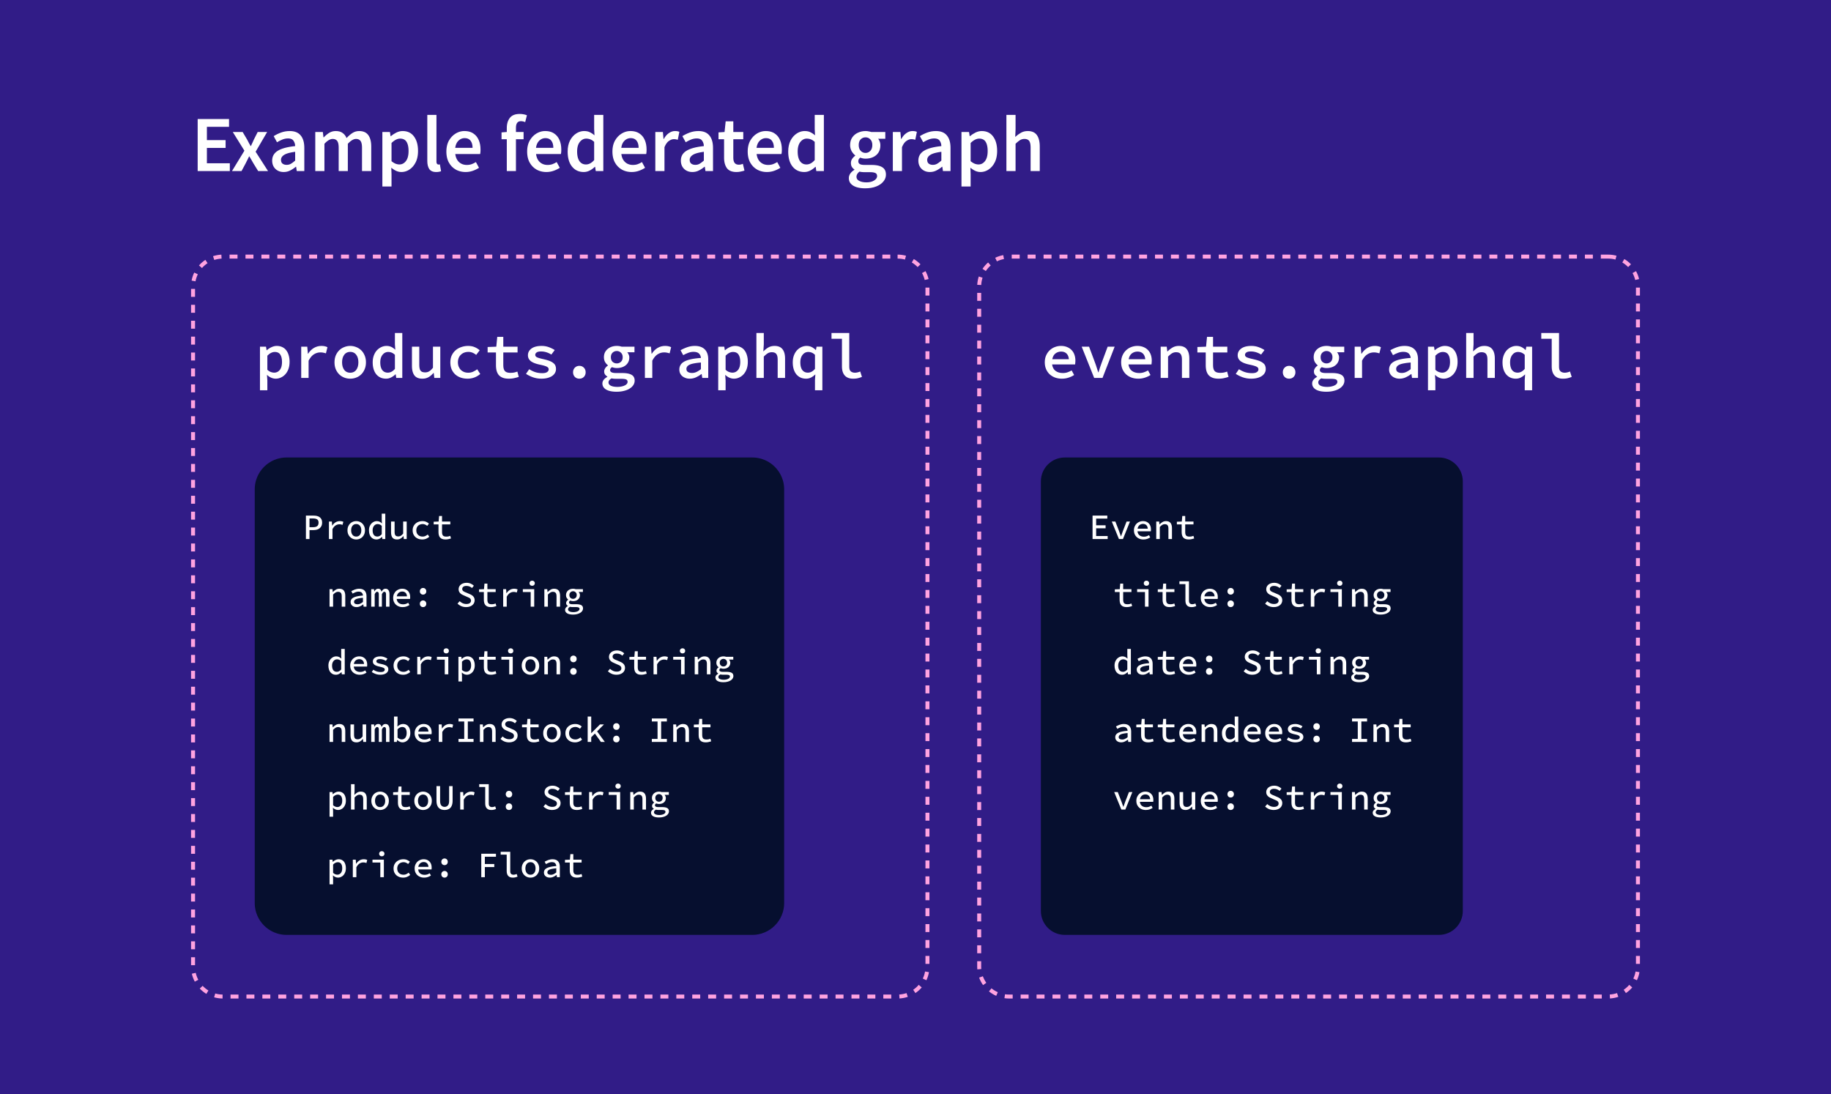
Federated Graph
=>
supergraph

Slide 6
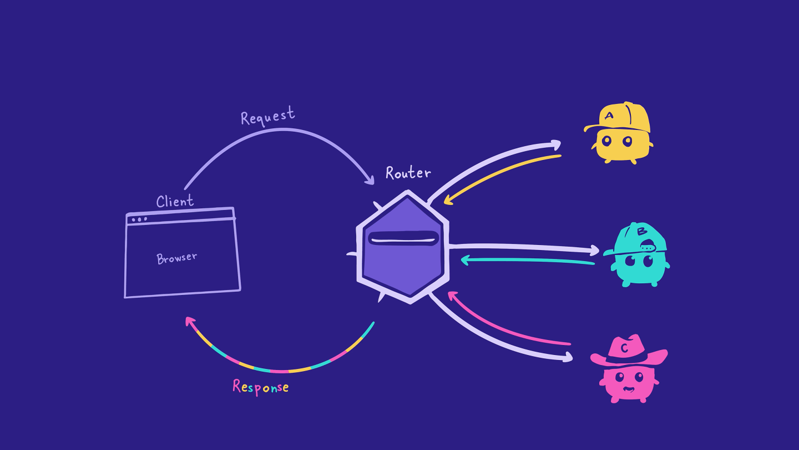
The router

Slide 7
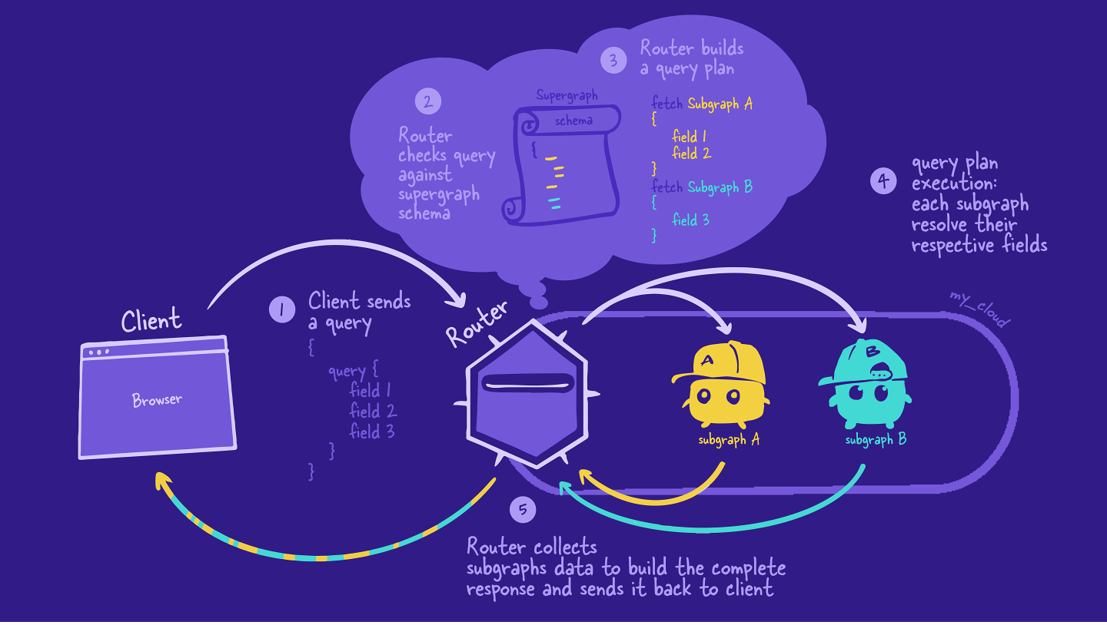
The query plan

Slide 8
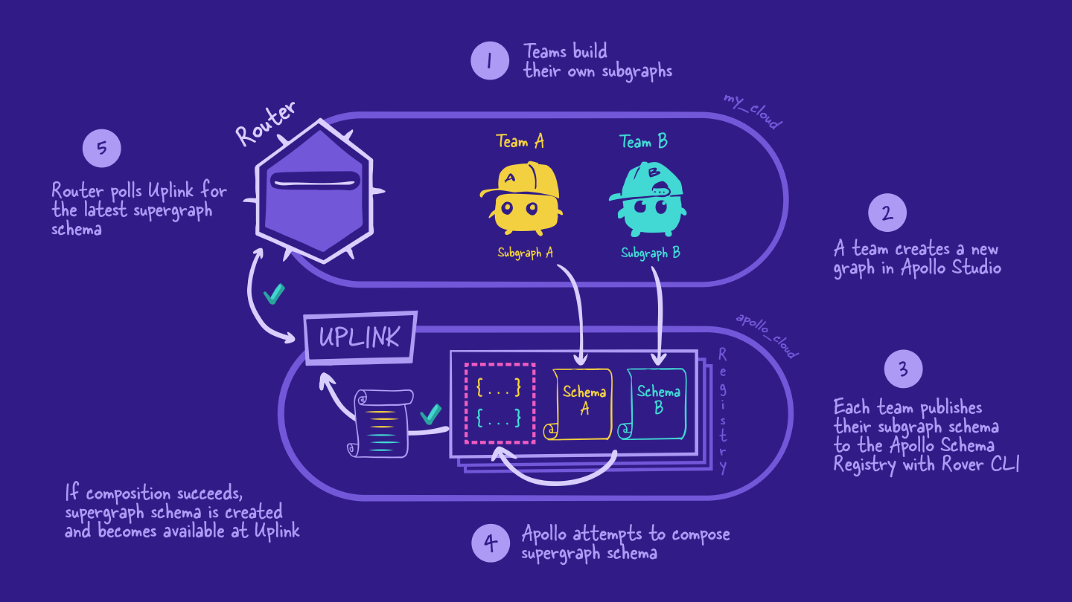
Managed federation workflow

Slide 9
Demo

Slide 12
Test
test
Notes:
Ease the path of our users to bring data into Archlet.

Slide 13
Today
Test
Test

Slide 14
Test
Test
Category Templates
Category one-pagers
Sales Demo Environment
Demo Bootcamp
Goal
Increase quick time-to-value and adoption
Collect and store knowledge and increase sourcing “authority”
Increase efficency and effectiveness in sales and CS team
Increase internal learning about tool usage and value
Channel
HelpCenter and in the future, directly in the product
Confluence, help center, blogs, website or webinars
Archlet app, confluence skipts and wikis
Confluence (join us on fridays ☺ )
Audience
SE, CSM & Users
Potential new customers, SE, CSMs
New customers or new users
Internal only

Slide 15

Questions

